Slide 1

Mepco Schlenk Engineering College (Autonomous)
Breast mass detection in Mammography images based on Improved Deep Transformed model
GUIDED BY,
Dr.B. Lakshmanan,
Associate Professor
CSE Department.
V. RAJA SUBRAMANIAN (20BCS046)
K. VIJAYA GOKUL (20BCS059)
Department of Computer Science and Engineering
1

Slide 2
Mepco Schlenk Engineering College (Autonomous)
Introduction
Breast cancer is a leading cause of death for women globally. Breast cancer starts when cells in the breast begin to grow abnormally and form a lump or tumor. To detect breast cancer Mammograms are used. Mammograms are X-ray images of the breasts which is used to detect breast cancer. Early detection of breast cancer is important for effective treatment and a better chance of survival. If breast cancer is not detected early, it can spread to other parts of the body and become more difficult to treat.
However, finding breast lumps in mammograms is challenging because the images can be complex because they have a lot of overlapping tissue making it difficult to distinguish between lumps and normal tissue. This is a problem because early detection of breast cancer is important for effective treatment and a better chance of survival. This project aims to develop a new method for detecting breast cancer in mammograms that is more accurate and easier to interpret.
Department of Computer Science and Engineering
2

Slide 3
Mepco Schlenk Engineering College (Autonomous)
Problem Statement
Breast cancer is a leading cause of death for women, but early detection is important and challenging.
This project aims to develop a new method for detecting breast cancer in mammograms that is more accurate and easier to interpret.
The goal of the project is to improve the accuracy and ease of interpretation of breast cancer detection in mammograms. This would lead to earlier detection of breast cancer, which would improve patient outcomes.
Department of Computer Science and Engineering
3

Slide 4
Mepco Schlenk Engineering College (Autonomous)
Objectives
To develop a new method for detecting breast cancer in mammograms that is more accurate and easier to interpret.
To train a Deep Learning model on a large dataset of mammogram images with and without breast cancer.
To reduce the number of false positive rates while detecting breast cancer in mammograms.
Department of Computer Science and Engineering
4

Slide 5
Mepco Schlenk Engineering College (Autonomous)
Expected Outcomes
A new method for detecting breast cancer in mammograms that is more accurate and easier to interpret.
A deep learning model is trained on a large dataset of mammogram images with and without breast cancer.
Detecting breast cancer in mammograms is done efficiently by reducing the number of false positive rates.
Department of Computer Science and Engineering
5

Slide 6
Mepco Schlenk Engineering College (Autonomous)
Literature Survey - 1
Lydia Bouzar-Benlabiod et al. (2023) performed a model in which they first used ResNext to conduct data cleansing on the CBIS-DDSM dataset, then combined SE-ResNet for segmentation and CBR for interpretable classification, and finally proposed a similarity measure for the CBR Retrieve module.
Lydia Bouzar-Benlabiod , Khaled Harrar, Lahcen Yamoun, Mustapha Yacine Khodja ,Moulay A. Akhloufi “A novel breast cancer detection architecture based on a cnn-cbr system for mammogram classification”, Computers in Biology and Medicine, Vol.no: 163, PP:107133, 2023
Department of Computer Science and Engineering
6

Slide 7
Mepco Schlenk Engineering College (Autonomous)
Literature Survey - 1 Contd./..
Merits:
This approach achieves high accuracy on the test set.
The approach uses a combination of CNN(Convolutional Neural Network) and CBR(Case-Based Reasoning System), which makes it more robust and interpretable than other approaches.
The approach can be used to improve the early detection and diagnosis of breast cancer.
Demerits:
The approach was only tested on a small dataset, so its performance on a larger population is unknown.
The approach is computationally expensive, so it may not be suitable for use in resource-limited settings.
Department of Computer Science and Engineering
7

Slide 8
Mepco Schlenk Engineering College (Autonomous)
Literature Survey - 2
Jihen Frikha Elleuch et al. (2023) they created a comprehensive framework for the transformation and fusion of medium-level features. Notably, exceptional rates of accuracy were achieved in detecting anomalies within breast tissues an 95.4% accuracy for mass detection and an 99.4% accuracy for micro-calcification detection.
Jihen Frikha Elleuch, Mouna Zouari Mehdi, Majd Belaaj, Norhène Gargouri Benayed, Dorra Sellami , Alima Damak “Breast cancer anomaly detection based on the possibility theory with a clustering paradigm”, Biomedical Signal Processing and Control, Vol.no: 79, PP: 104043,2023.
Department of Computer Science and Engineering
8

Slide 9
Mepco Schlenk Engineering College (Autonomous)
Literature Survey - 2 Contd./..
Merits:
Improved accuracy in mass and microcalcification detection.
Better handling of the high uncertainty level in breast tissue anomaly classification.
Possibility-necessity based decision making can provide a more efficient and effective way of assigning samples to different classes.
Demerits:
The proposed approach may require a large amount of data to train the models and achieve high accuracy.
The possibility-based modeling formalism may be more complex and difficult to implement than other traditional methods.
The proposed approach may not be suitable for all types of breast tissue anomalies or may not generalize well to other datasets.
Department of Computer Science and Engineering
9

Slide 10
Mepco Schlenk Engineering College (Autonomous)
Literature Survey - 3
Hamed Pezeshki’s research aims to improve mammogram image segmentation by focusing on key regions. It extracts spiculated areas and mass cores simultaneously, using pixel patterns for spiculated regions and pixel similarity for mass cores. By removing redundant pixels through thresholding and combining regions, the method ensures accurate tumor segmentation. This advancement has potential for enhancing medical diagnoses.
Hamed Pezeshki, “Breast tumor segmentation in digital mammograms using spiculated regions”, Biomedical Signal Processing and Control Vol.no: 76, PP: 103652,2022.
Department of Computer Science and Engineering
10

Slide 11
Mepco Schlenk Engineering College (Autonomous)
Literature Survey - 3 Contd./..
Merits:
The technique accurately extracts the mass core (central region) and spiculated regions which contain the tumor border details.
The technique significantly discriminated between the shape of malignant and benign masses.
The technique resulted in higher accuracy and fewer calculations required to extract the considerable and spiculated regions of the masses effectively.
Demerits:
The α, β and γ thresholds affect the extraction of the spiculated regions and mass core, so future research could focus on optimizing these thresholds.
More effective pre-processing methods could be applied to help extract the details of the mass core and the spiculated parts more precisely.
Department of Computer Science and Engineering
11

Slide 12
Mepco Schlenk Engineering College (Autonomous)
Literature Survey - 4
Ghada Hamed Aly, et al. (2021), proposed an efficient single-pass approach for mammogram detection using YOLO. Their work targets the automation of breast mass detection and classification, seeking to replace error-prone human evaluations with precise and effective methods.
Ghada Hamed Aly, Mohammed Marey, Safaa Amin El-Sayed, Mohamed Fahmy Tolba, “YOLO Based Breast Masses Detection and Classification in Full-Field Digital Mammograms”, Computer Methods and Programs in Biomedicine, Vol.no: 200, PP: 105823,2021.
Department of Computer Science and Engineering
12

Slide 13
Mepco Schlenk Engineering College (Autonomous)
Literature Survey - 4 Contd./..
Merits:
The use of anchor boxes concept in YOLO-V3 that are generated by applying k-means clustering on the dataset allows for the detection of most of the challenging cases of masses and their correct classification.
Augmenting the dataset using different approaches, and comparing with other recent YOLO based studies, found that augmenting the training set only is the fairest and most accurate to be applied in realistic scenarios.
Demerits:
YOLO-V3 is a good model for detecting small objects, but it has some limitations. For example, it can't detect small masses that are close together very well.
Department of Computer Science and Engineering
13

Slide 14
Mepco Schlenk Engineering College (Autonomous)
Literature Survey - 5
Asma Baccouche et al.(2022) proposed an precise early breast cancer diagnosis through deep learning techniques. Their YOLO-based model achieves simultaneous detection and classification of suspicious lesions in digital mammograms. The objective is to minimize unwarranted biopsies and enhance survival rates.
Asma Baccouche, Begonya Garcia-Zapirain, Yufeng Zheng, Adel S. Elmaghraby, “Early detection and classification of abnormality in prior mammograms using image-to-image translation and YOLO techniques”, Computer Methods and Programs in Biomedicine, Vol.no: 221, PP: 106884,2022.
Department of Computer Science and Engineering
14

Slide 15
Mepco Schlenk Engineering College (Autonomous)
Literature Survey - 5 Contd./..
Merits:
The integration of Prior mammograms from all used follow-up screenings to provide an early detection and classification on initial screened mammograms is important because it can help to identify abnormalities that may have been missed in earlier screenings.
The use of image-to-image translation techniques to create new translated Prior mammograms that can overcome the misalignment between the two screenings due to temporal and texture changes helps to improve the accuracy of the detection and classification results.
Demerits:
It used a two-stage approach to detection and classification. This means that the model first detected the lesions, and then it classified the lesions. This can lead to errors if the model incorrectly detects a lesion.
Department of Computer Science and Engineering
15

Slide 16
Mepco Schlenk Engineering College (Autonomous)
Literature Survey - 6
Steven J. Frank (2023) proposed a comprehensive approach that involves integrating a deep learning architecture containing both an object-detection algorithm and a convolutional neural network. Specifically, the study utilizes the YOLO v5 object-detection algorithm as its chosen method.
Steven J. Frank, “A deep learning architecture with an object-detection algorithm and a convolutional neural network for breast mass detection and visualization”, Healthcare Analytics, Vol.no: 3, PP: 100186,2023.
Department of Computer Science and Engineering
16

Slide 17
Mepco Schlenk Engineering College (Autonomous)
Literature Survey - 6 Contd./..
Merits:
The proposed system can reduce the time and effort required for radiologists to review mammograms and improve the accuracy of breast mass detection.
Demerits:
False positives, which can lead to reviewer frustration and diminish confidence in a tool's effectiveness, are a potential shortcoming of object-detection systems.
Department of Computer Science and Engineering
17

Slide 18
Mepco Schlenk Engineering College (Autonomous)
Literature Survey - 7
Fei Yan et al. (2023) proposed a methodology that evaluates a breast cancer detection strategy using ensemble classifiers and feature weighting algorithms.
Diagnostic accuracy is experimentally assessed, with two key algorithms employed:
Artifact removal within the breast region.
Removal of abnormal areas in regions of interest.
Fei Yan, Hesheng Huang, Witold Pedrycz , Kaoru Hirota, “Automated breast cancer detection in mammography using ensemble classifier and feature weighting algorithms”, Expert Systems with Applications, Vol.no: 227, PP:120282,2023.
Department of Computer Science and Engineering
18

Slide 19
Mepco Schlenk Engineering College (Autonomous)
Literature Survey - 7 Contd./..
Merits:
The proposed scheme could be highly practical and effective for helping radiologists to detect breast cancer, greatly reducing the incidence of false positives and false negatives.
Demerits:
A label or artifact is attached to the breast region, which cannot be removed using the proposed region extraction method.
Large breast cancer datasets cannot be employed in the proposed scheme because they are very difficult to obtain.
Department of Computer Science and Engineering
19

Slide 20
Mepco Schlenk Engineering College (Autonomous)
Literature Survey - 8
Khaoula Belhaj Soulami et al. (2022) proposed Capsule based Deep learning model to classify suspicious masses in the breast into normal, benign, and malignant. Used Dynamic Routing algorithm.
Khaoula Belhaj Soulami, Naima Kaabouch, Mohamed Nabil Saidi, “Breast cancer: Classification of suspicious regions in digital mammograms based on capsule network”, Biomedical Signal Processing and Control, Vol.no: 76, PP: 103696,2022.
Department of Computer Science and Engineering
20

Slide 21
Mepco Schlenk Engineering College (Autonomous)
Literature Survey - 8 Contd./..
Merits:
The proposed model shows good performance for binary classification and multiclassification of suspicious breast masses, particularly for extremely dense mammograms.
Demerits:
The binary classification of masses into normal and abnormal achieves an accuracy of 96.03% whereas the multiclassification of breast masses into normal, benign, and malignant scores an accuracy of 77.78% which is less than binary classification.
Department of Computer Science and Engineering
21

Slide 22
Mepco Schlenk Engineering College (Autonomous)
Literature Survey - 9
Volkan Müjdat Tiryaki (2023) proposed cascaded U-net++Xception deep learning pipeline. It doesn't necessitate the inclusion of clinical data, highlighting the potential for accurate and efficient diagnostic outcomes solely from the image-based methodology.
Volkan Müjdat Tiryaki, “Mass segmentation and classification from film mammograms using cascaded deep transfer learning”, Biomedical Signal Processing and Control, Vol.no: 84, PP: 104819,2023.
Department of Computer Science and Engineering
22

Slide 23
Mepco Schlenk Engineering College (Autonomous)
Literature Survey - 9 Contd./..
Merits:
The proposed model may be used to reduce the workload of radiologists for mass detection, segmentation, and classification which are all crucial mammogram interpretation steps.
The proposed model is useful for breast cancer mass segmentation and classification on BCDR dataset and may be useful on additional mammogram datasets.
Demerits:
A cascaded approach increases the requirement for both computational resources and the amount of training data.
BCDR and other datasets lack performance comparison between different radiologists so there is an uncertainty for setting an accomplishment level for the deep learning model.
Department of Computer Science and Engineering
23

Slide 24
Mepco Schlenk Engineering College (Autonomous)
Literature Survey - 10
Subasish Mohapatra et.al (2022) proposed a Convolution Neural Network(CNN) method for developing an automatic detection mechanism to classify breast cancer masses and noncancerous masses from mammogram images. They compared the results of different CNN models to achieve better accuracy in classification.
Subasish Mohapatra , Sarmistha Muduly, Subhadarshini Mohanty, J V R Ravindra, Sachi Nandan Mohanty, “Evaluation of deep learning models for detecting breast cancer using histopathological mammograms Images”, Sustainable Operations and Computers, Vol.no: 3, Page No: 296–302 ,2022.
Department of Computer Science and Engineering
24

Slide 25
Mepco Schlenk Engineering College (Autonomous)
Literature Survey - 10 Contd./..
Merits:
Provides a comparative study of various CNN architectures' results for breast cancer detection using mammogram images.
Compares the performance of CNN models using two methods: training the model from scratch and training the model with pre-trained weights.
Concludes that when the classifiers are applied with transfer learning, the accuracy achieved is better than training from scratch.
Demerits:
Only focuses on the performance of CNN models for breast cancer detection using mammogram images.
Does not explore other deep learning approaches, such as recurrent neural networks or generative adversarial networks.
Only uses a limited number of datasets, which may not be representative of all possible scenarios.
Department of Computer Science and Engineering
25

Slide 26
Mepco Schlenk Engineering College (Autonomous)
Literature Survey - Contd./..
Consolidation of the literatures:
S.No | Author(s) & Year | Methodology Used | Limitations
1. | Lydia Bouzar-Benlabiod , Khaled Harrar, Lahcen Yamoun, Mustapha Yacine Khodja and Moulay A. Akhloufi ,2023. | Utilized ResNext, SE-ResNet, and CBR for robust mammogram analysis. Outperformed existing approaches. | Limited Generalization, Costly.
2. | Jihen Frikha Elleuch, Mouna Zouari Mehdi, Majd Belaaj, Norhène Gargouri Benayed, Dorra Sellami and Alima Damak ,2023. | Developed framework for Transform and fuse features. | Complex Modelling, Limited Applicability
3. | Hamed Pezeshki,2022. | Enhanced mammogram segmentation, simultaneous spiculated and mass core extraction, pixel-based analysis. | Threshold Optimization required, Enhanced Pre-processing needed.
Department of Computer Science and Engineering
26

Slide 27
Mepco Schlenk Engineering College (Autonomous)
Literature Survey - Contd./..
Consolidation of the literatures:
S.No | Author(s) & Year | Methodology Used | Limitations
4. | Ghada Hamed Aly, Mohammed Marey, Safaa Amin El-Sayed and Mohamed Fahmy Tolba,2021. | used YOLO, an efficient single-pass approach for mammogram detection | YOLO-V3 is a good model for detecting small objects, but it has some limitations.
5. | Asma Baccouche, Begonya Garcia-Zapirain, Yufeng Zheng and Adel S. Elmaghraby ,2022. | Deep learning for breast cancer diagnosis; YOLO model detects lesions. | Two-stage detection, classification; risk of errors in lesion detection.
6. | Steven J. Frank,2023. | Capsule based Deep learning model to classify suspicious masses in the breast into normal, benign, and malignant. | Binary achieves 96.03%, multiclass 77.78% accuracy, comparatively lower.
Department of Computer Science and Engineering
27

Slide 28
Mepco Schlenk Engineering College (Autonomous)
Literature Survey - Contd./..
Consolidation of the literatures:
S.No | Author(s) & Year | Methodology Used | Limitations
7. | Fei Yan, Hesheng Huang, Witold Pedrycz , Kaoru Hirota,2023. | Based on ensemble classifier and feature weighting algorithms, | Preparing the right format of the training configuration for the YOLO-based model.
8. | Khaoula Belhaj Soulami, Naima Kaabouch and Mohamed Nabil Saidi,2022. | YOLO architecture model for simultaneous detection and classification of breast lesions was proposed. | Separation Challenge, Difficulty in Acquisition
Department of Computer Science and Engineering
28

Slide 29
Mepco Schlenk Engineering College (Autonomous)
Literature Survey - Contd./..
Consolidation of the literatures:
S.No | Author(s) & Year | Methodology Used | Limitations
9. | Volkan Müjdat Tiryaki,2023. | Cascaded U-net++Xception deep learning pipeline without clinical data. | False Positives are a potential shortcoming of object-detection systems.
10. | Subasish Mohapatra , Sarmistha Muduly, Subhadarshini Mohanty, J V R Ravindra, Sachi Nandan Mohanty, 2023. | Used the Mini-DDSM dataset and used three different CNN architectures AlexNet, VGG16, and ResNet50 architectures | Limited dataset. Not well-suited for medical images, trained only on large dataset of natural images
Department of Computer Science and Engineering
29

Slide 30
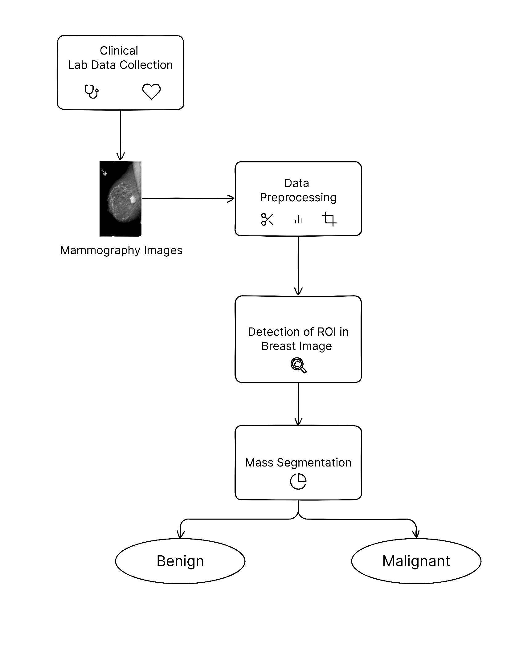
Mepco Schlenk Engineering College (Autonomous)
System design
Department of Computer Science and Engineering
30

Slide 31
Mepco Schlenk Engineering College (Autonomous)
Module Description
Data Preprocessing
DICOM (Digital Imaging and Communications in Medicine) is a special medical image file format, contains the mammography images. We converted the DICOM format to JPEG format.
DICOM Images
DICOM Converter
JPEG Format
DICOM Images
DICOM Converter
Department of Computer Science and Engineering
31

Slide 32
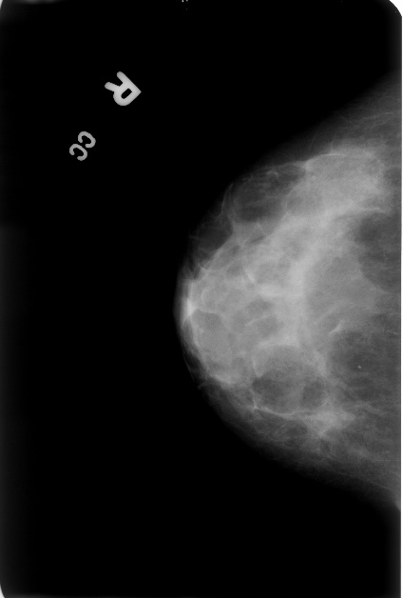
Mepco Schlenk Engineering College (Autonomous)
Module Description
Adaptive Denoising:
Here, the mammograph images contain additional signs at the upper right corner or upper left corner and in some situations at the bottom of converted jpeg image. To remove such non-informative noise, we are using adaptive denoising algorithm.
Adaptive denoising is a method of removing digital noise from a picture.
Mammograpy Image
Removed Signs in the Image
Department of Computer Science and Engineering
32

Slide 33
Mepco Schlenk Engineering College (Autonomous)
Module Description
Adaptive Cropping:
Cropped 2.5% from the top and bottom of the original image.
Cropped Image
Removed Sign in the Image
Department of Computer Science and Engineering
33

Slide 34
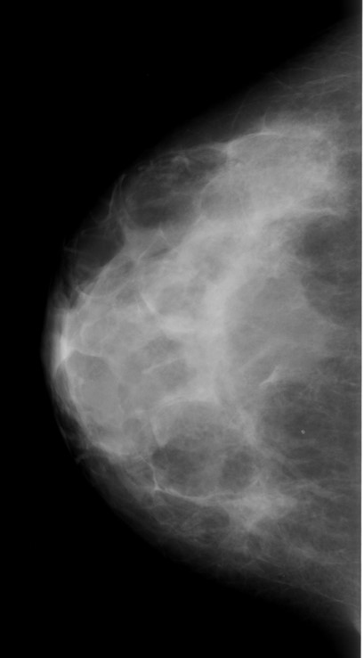
Mepco Schlenk Engineering College (Autonomous)
Module Description
Adaptive Padding:
In Adaptive padding the cropped image is resized to the size of the original image.
Cropped Image
Resizing to Original Size
Department of Computer Science and Engineering
34

Slide 35
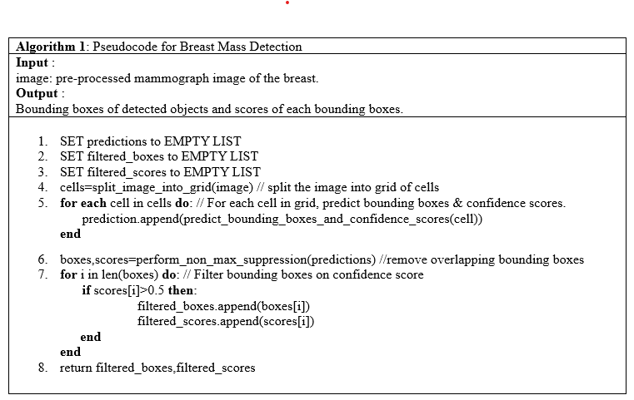
Mepco Schlenk Engineering College (Autonomous)
Module Description
Algorithm for Detection of ROI in Breast Image
Department of Computer Science and Engineering
35

Slide 36
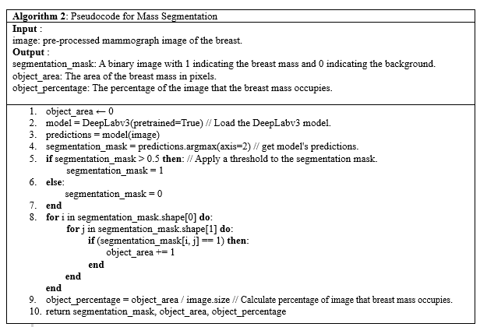
Mepco Schlenk Engineering College (Autonomous)
Module Description
Algorithm for Mass Segmentation
Department of Computer Science and Engineering
36

Slide 37
Mepco Schlenk Engineering College (Autonomous)
Evaluation Metrics
True Positive Rate:
TPR = TP / (TP + FN)
True positive (TP): model correctly predicts a positive case.
False Negative (FN): model incorrectly identifies a positive case as a negative case.
The TPR is a measure of the sensitivity of a test or model.
A higher TPR indicates that the test or model is better at identifying positive cases.
Department of Computer Science and Engineering
37

Slide 38
Mepco Schlenk Engineering College (Autonomous)
Evaluation Metrics
Precision
Precision = TP / (TP + FP)
True positive (TP): the model correctly predicts a positive case.
False positive (FP): the model incorrectly predicts a positive case.
Precision measures the ability of a model to avoid identifying negative cases as positive cases.
Department of Computer Science and Engineering
38

Slide 39
Mepco Schlenk Engineering College (Autonomous)
Evaluation Metrics
F1-Score
F1-Score = 2 * (Precision * Recall) / (Precision + Recall)
The F1 score is a measure of the performance of a model that considers both the precision and recall of the model.
Department of Computer Science and Engineering
39

Slide 40
Mepco Schlenk Engineering College (Autonomous)
Evaluation Metrics
IoU (Intersection over Union)
IoU = TP / (TP + FP + FN)
True positive (TP): the model correctly predicts a positive case.
False positive (FP): the model incorrectly predicts a positive case.
False Negative (FN): the model incorrectly identifies a positive case as a negative case.
The IoU (Intersection over Union) is a measure of the overlap between a predicted bounding box and a ground truth bounding box.
It is calculated by dividing the number of pixels that are common to both boxes by the sum of the number of pixels in both boxes.
Department of Computer Science and Engineering
40

Slide 41
Mepco Schlenk Engineering College (Autonomous)
Implementation results and discussion
Implementation is not yet started.
Department of Computer Science and Engineering
41

Slide 42
Mepco Schlenk Engineering College (Autonomous)
Work(s) completed so far
Data Collection
Department of Computer Science and Engineering
42

Slide 43
Mepco Schlenk Engineering College (Autonomous)
Work(s) yet to complete
Data Preprocessing
Detection
Segmentation
Department of Computer Science and Engineering
43

Slide 44
Mepco Schlenk Engineering College (Autonomous)
REFERENCES
Yongye Su , Qian Liu , Wentao Xie , Pingzhao Hu, “YOLO LOGO: A transformer-based YOLO segmentation model for breast mass detection and segmentation in digital mammograms”, Computer methods and programs in Biomedicine, Elsevier, Vol.no: 221, PP: 106903, 2022.
Lydia Bouzar-Benlabiod , Khaled Harrar, Lahcen Yamoun, Mustapha Yacine Khodja ,Moulay A. Akhloufi “A novel breast cancer detection architecture based on a cnn-cbr system for mammogram classification”, Computers in Biology and Medicine, Vol.no: 163, PP:107133, 2023.
Jihen Frikha Elleuch, Mouna Zouari Mehdi, Majd Belaaj, Norhène Gargouri Benayed, Dorra Sellami , Alima Damak “Breast cancer anomaly detection based on the possibility theory with a clustering paradigm”, Biomedical Signal Processing and Control, Vol.no: 79, PP: 104043,2023.
Department of Computer Science and Engineering
44

Slide 45
Mepco Schlenk Engineering College (Autonomous)
REFERENCES
Hamed Pezeshki, “Breast tumor segmentation in digital mammograms using spiculated regions”, Biomedical Signal Processing and Control Vol.no: 76, PP: 103652,2022.
Ghada Hamed Aly, Mohammed Marey, Safaa Amin El-Sayed, Mohamed Fahmy Tolba, “YOLO Based Breast Masses Detection and Classification in Full-Field Digital Mammograms”, Computer Methods and Programs in Biomedicine, Vol.no: 200, PP: 105823,2021.
Steven J. Frank, “A deep learning architecture with an object-detection algorithm and a convolutional neural network for breast mass detection and visualization”, Healthcare Analytics, Vol.no: 3, PP: 100186,2023.
Department of Computer Science and Engineering
45

Slide 46
Mepco Schlenk Engineering College (Autonomous)
REFERENCES
Fei Yan, Hesheng Huang, Witold Pedrycz , Kaoru Hirota, “Automated breast cancer detection in mammography using ensemble classifier and feature weighting algorithms”, Expert Systems with Applications, Vol.no: 227, PP:120282,2023.
Khaoula Belhaj Soulami, Naima Kaabouch, Mohamed Nabil Saidi, “Breast cancer: Classification of suspicious regions in digital mammograms based on capsule network”, Biomedical Signal Processing and Control, Vol.no: 76, PP: 103696,2022.
Volkan Müjdat Tiryaki, “Mass segmentation and classification from film mammograms using cascaded deep transfer learning”, Biomedical Signal Processing and Control, Vol.no: 84, PP: 104819,2023.
Department of Computer Science and Engineering
46

Slide 47
Mepco Schlenk Engineering College (Autonomous)
REFERENCES
Subasish Mohapatra , Sarmistha Muduly, Subhadarshini Mohanty, J V R Ravindra, Sachi Nandan Mohanty, “Evaluation of deep learning models for detecting breast cancer using histopathological mammograms Images”, Sustainable Operations and Computers, Vol.no: 3, Page No: 296–302 ,2022.
Asma Baccouche, Begonya Garcia-Zapirain, Yufeng Zheng, Adel S. Elmaghraby, “Early detection and classification of abnormality in prior mammograms using image-to-image translation and YOLO techniques”, Computer Methods and Programs in Biomedicine, Vol.no: 221, PP: 106884,2022.
Department of Computer Science and Engineering
47

Slide 48
Mepco Schlenk Engineering College (Autonomous)
THANK YOU
Department of Computer Science and Engineering
48

